Slide 1
Summary overview report on development of MPH chapter for functional materials for year 2016
WPMAT
MAT-1.2.1-T006-D001
F. Gillemot, MTA EK
I. Szenthe, MTA EK
Kovács, MTA EK

Slide 2

Introduction:
MTA EK participated in IAEA IRPVMD database, in ITER MPH elaboration.
Decision: MTA EK knowledge may used in WPMAT at elaboration DEMO MPH and Material Database
2014. Harmonized Material Database and MPH structure with sample files for structural, joint, armour, and functional materials prepared, accepted
2015. Decision that only functional materials database is the task of MTA EK
2016. The first version of Functinal Materials MPH elaborated following the format accepted for EUROFER chapter
Notes:
2

Slide 3
Objectives:
To summarize the available knowledge on Functional Material properties for designers and to finalize the DEMO MPH format
The purpose of WPMAT is provide comprehensive and understandable information to the designers, and to the authorities. This is supported by public money.
Tasks in 2016
As part of the WBS1.2 goal to develop a material handbook summarising the database content at a higher level.The target for 2016 is to generate and release a Material Property Handbook (MPH) for at least one material. Alumina is selected as pilot chapter

Slide 4
Co-operation with the Functional Materials Group:
MTA EK representative participated on all Functional Materials subgroup meeting.
The purpose of database and MPH presented at all meetings
At August 2016 the database and the MPH draft had been sent to the subgroup and contributions required (not many arrived)

Slide 5
Working method 1:
Selection of the content of the MPH (Functional Material)
(from the general MPH list elaborated 2014) useful for the designers.
Selected 27 properties
General information, Chemical composition, Density,Grain size
Maximum use temperature, Melting point, Porosity
Absorption, Relative permittivity, Dielectric Loss or Loss of tangent
Dielectric Strength, Electrical resistivity, Permittivity
Reflectance, Specific heat, Thermal conductivity
Thermal diffusivity, Linear thermal expansion
Thermal schock resistance, Bulk modulus
Compressive strength, Young’s modulus
Flexural strength, Fracture toughness
Hardness, Poisson’s ratio, Shear modulus

Slide 6
Working methods 2:
Collection MPH data are from 2 sources: WPMAT reports, literature
Selection of the relevant information
Data quality:
High - original report or database data from original reports
Low to high – public data (conferences, journals etc.) consideration on quality
No identification – very low or useless
Identification – enough data to get the same quality

Slide 7

Working method 3:
Description of the property
The density, or more precisely, the volumetric mass density [kg/m³ or g/cm³], of a substance is its mass per unit volume. The symbol most often used for density is ρ (the lower case Greek letter „rho”). Mathematically, density is defined as mass divided by volume:
where ρ is the density, m is the mass, and V is the volume

Slide 8
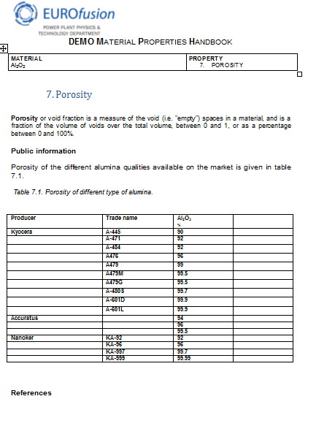
Working method 4
General alumina properties from
Catalogues, open literature
Figure and references will be included
May assist the designer in case of missing relevant research data

Slide 9
Working method 5:
Attach the relevant references: standards, literature
O. Sidletskiy et al.: „Structure property correlations in a Ce doped Lu, Gd, 2SiO5 Ce scintillator”. Cryst. Growth Des. 12 2012 4411 4416
Lushchik et al.: “Influence of complex impurity centres on radiation damage in wide-gap metal oxides”. Nuclear Instruments and Methods in Physics Research Section B Beam Interactions with Materials and Atoms August 2015
R. Zabels et al.: “Depth profiles of indentation hardness and dislocation mobility in MgO single crystals irradiated with swift 84Kr and 14N ions” Appl. Phys
J. Mollii, et all: “Insulator dielectric properties during irradiation and influence of RIED effect” Journal of Nuclear Materials 212-215 (1994) 1113-1118
Uberuaga P B et al.: „Opposite correlations between cation disordering and amorphization resistance in spinels versus pyrochlores“ Nature Communications 29 October 2015
Gilbert C A et al. „A theoretical study of intrinsic point defects and defect clusters in magnesium aluminate spinel“ J. Phys. Condens. Matter 21 (2009)
Sawai S and Uchino T: „Visible photoluminescence from MgAl2O4 spinel with cation disorder and oxygen vacancy“, J. Appl. Phys. 112 (2012) 103523
Ibarra et al.: “High dose neutron irradiation of MgAl2O4 spinel effects of post irradiation thermal annealing on EPR and optical absorption” Journal of Nuclear Materials 336 (2005) 156–162

Slide 10
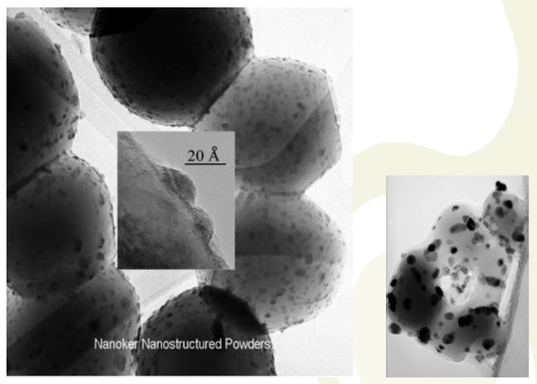
Working method 6
Summarize the existing Functional Materials reports
Reports are on alumina developed for purpose
NKR-HPA- Sample ID | Fabrication route | # of samples | dimensions (mm) | Comment
C (casted) | Slip casting+ sintering route A Slip is poured into s plaster mould that draws water from the poured slip to compact and form the casting. When dry, the solid clay can be removed and fired at high T. | 5 | ø – 30 Thick - 2 | In theory splip-casting methods provide superior surface quality, density and uniformity in casting high-purity ceramic raw materials with little additives.
References
FM -4.2.2.D1- Development of different self-doped alumina grades by using colloidal routes and advanced processing technologies (EFDA_D_2M9NJP v1.0)
MAT 4.2.2-T2-D3 Samples selection and procurement for testing pre-irradiation dielectric properties (EFDA_D_2MP4G7 v1.2)

Slide 11
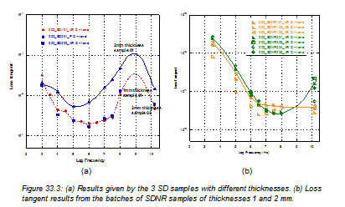
Working method 7:
Provide the simplified design information

Slide 12
Acceptance criteria:
Project management check
Discussion with the designers (future after the finish of the pilot chapter)
Results:
Draft of the Pilot chapter of the MPH is elaborated and provided for discussion and for contributions to the FM research subgroup. MTA EK participated on all FM subgroup meetings and provided information on the database and MPH.
Conclusions:
Enhanced co-operation with the FM subgroup is required to finish the MPH chapter on Alumina and include the other functional materials.

Slide 13
Midterm–Review: Objectives-Status for the 5 year period
Objective(s):
Continue developement the FM MPH depend on the relevant materials, data integration into MPH
Achievement and status:
Report the achievements : the pilot chapter Alumina of the Functional Material MPH version 1.1
Need a stronger cooperation with the specialist : videoconferences, meetings
Interaction : connection with Functional Material database, with all task of Functional Material Subproject
Outlook: FM database to help the designers

Slide 14
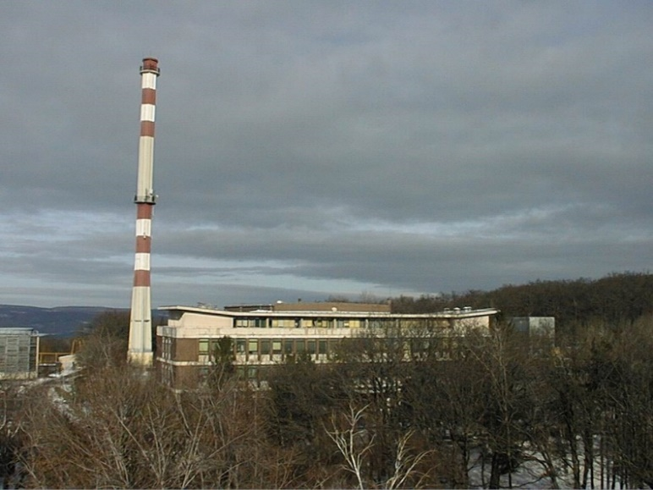
Thank you for your attention!

